Slide 1
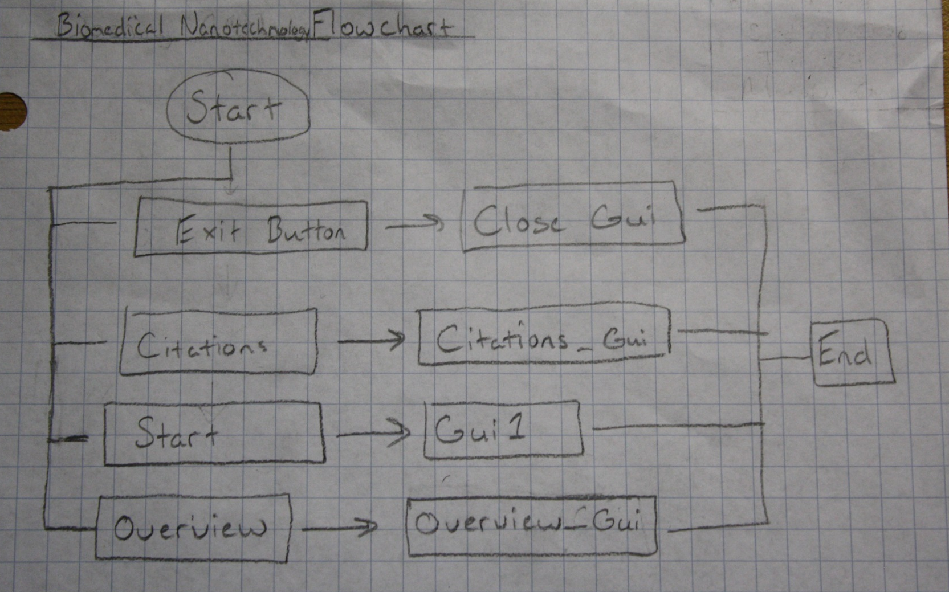
Adam Ribblett
Apoorv Gaur
Junpeng Qiu
Leigh Nelson
Biomedical Nanotechnology
Section 008
Team 24
Adam Ribblett will design this GUI.

Slide 2
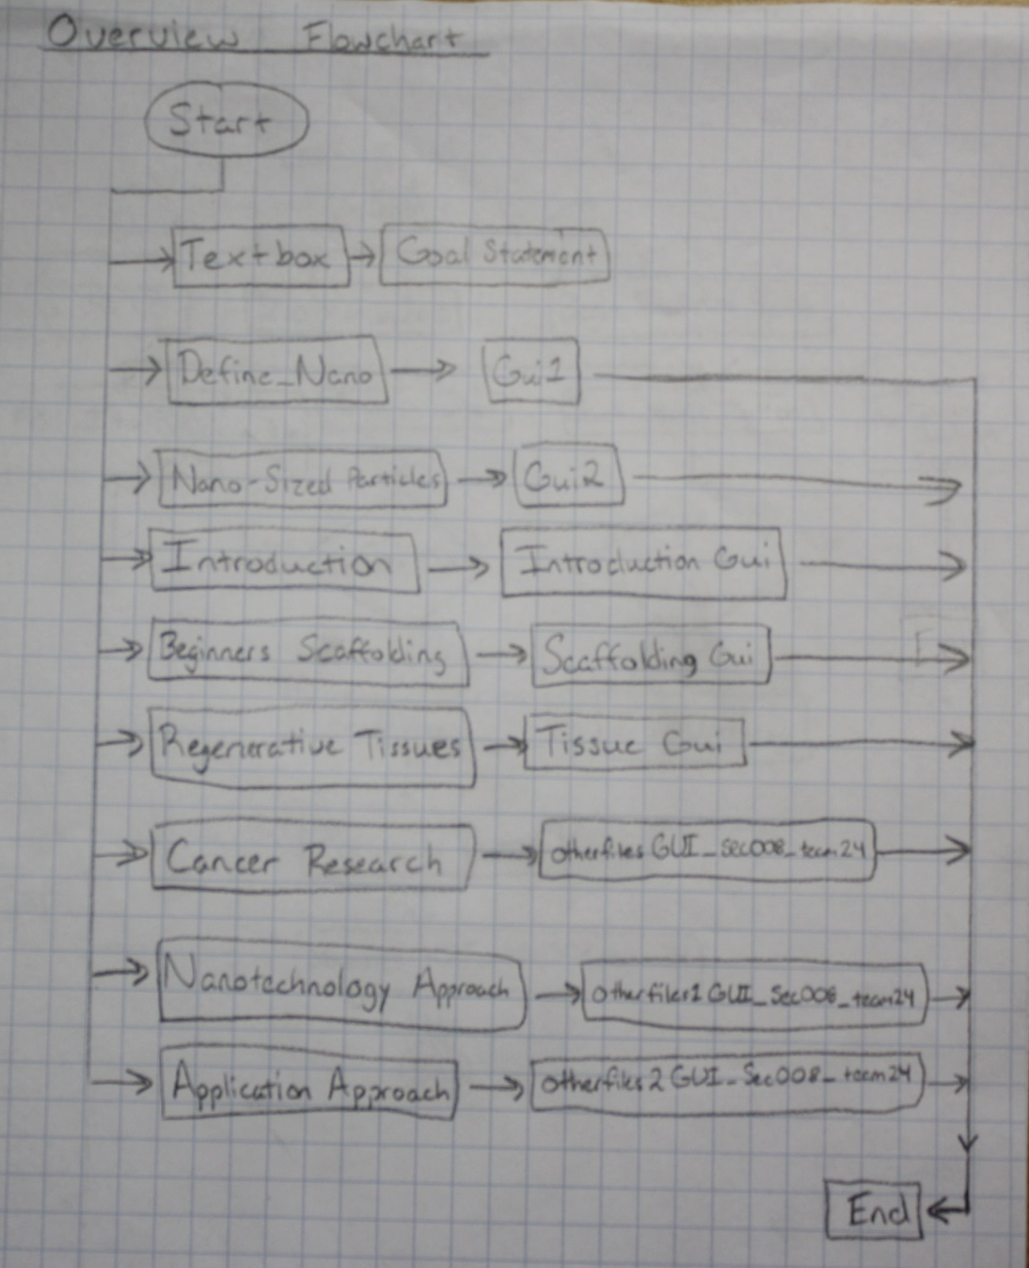
Overview
Adam Ribblett will design this GUI.

Slide 3
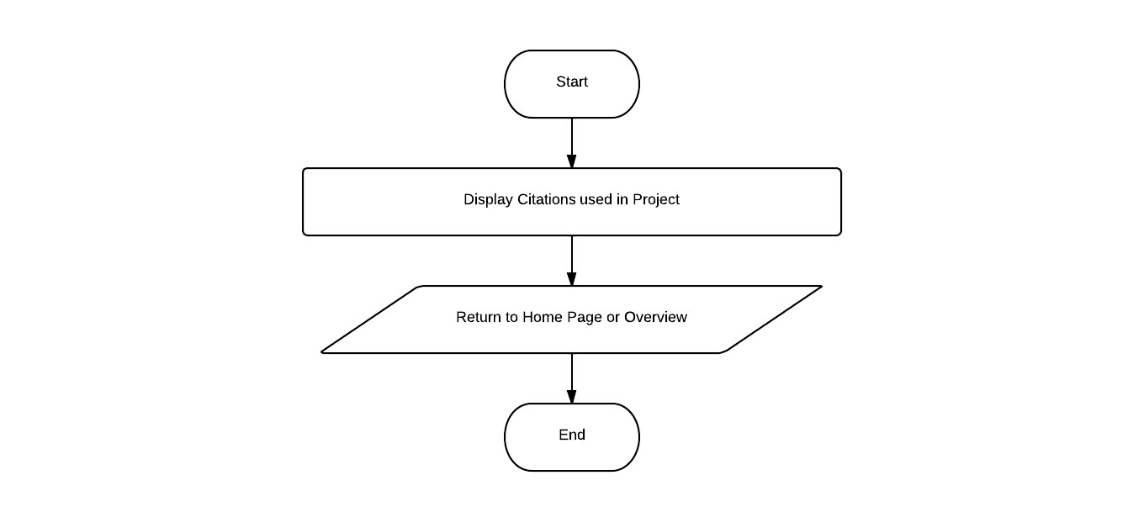
Citations
Leigh Nelson will design this GUI.

Slide 4
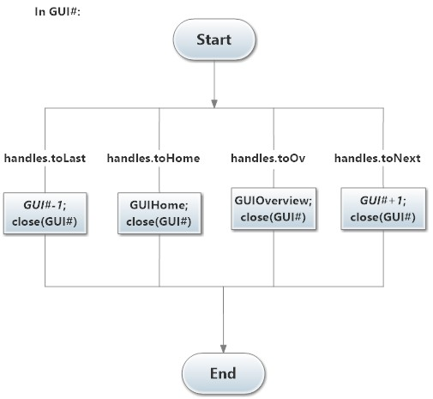
Navigation Buttons
<<
Home
Overview
>>

Slide 5
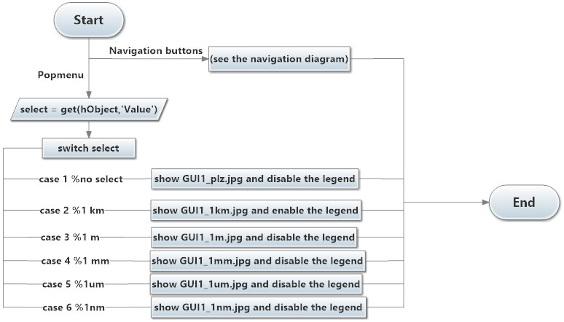
Scale & Size
Define One Nanometer
Junpeng Qiu will design this GUI.

Slide 6
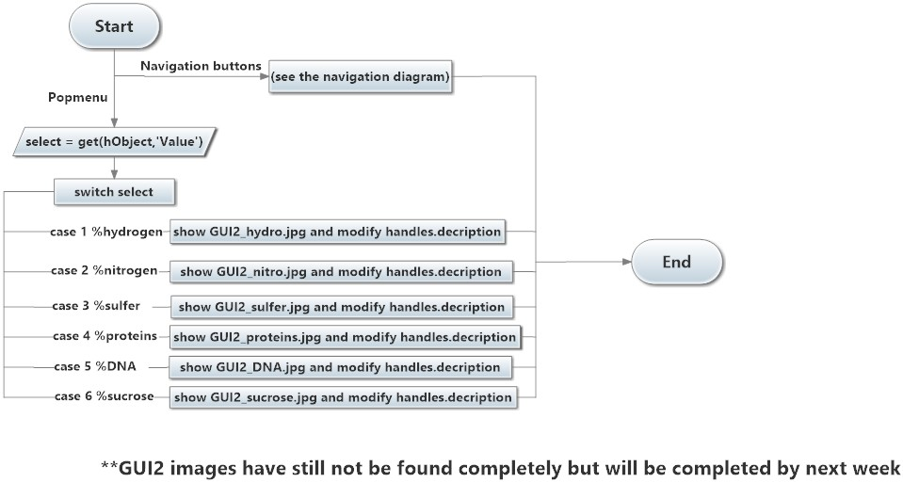
Scale & Size
Zoom-in to Nano-sized Particles
Junpeng Qiu will design this GUI.

Slide 7
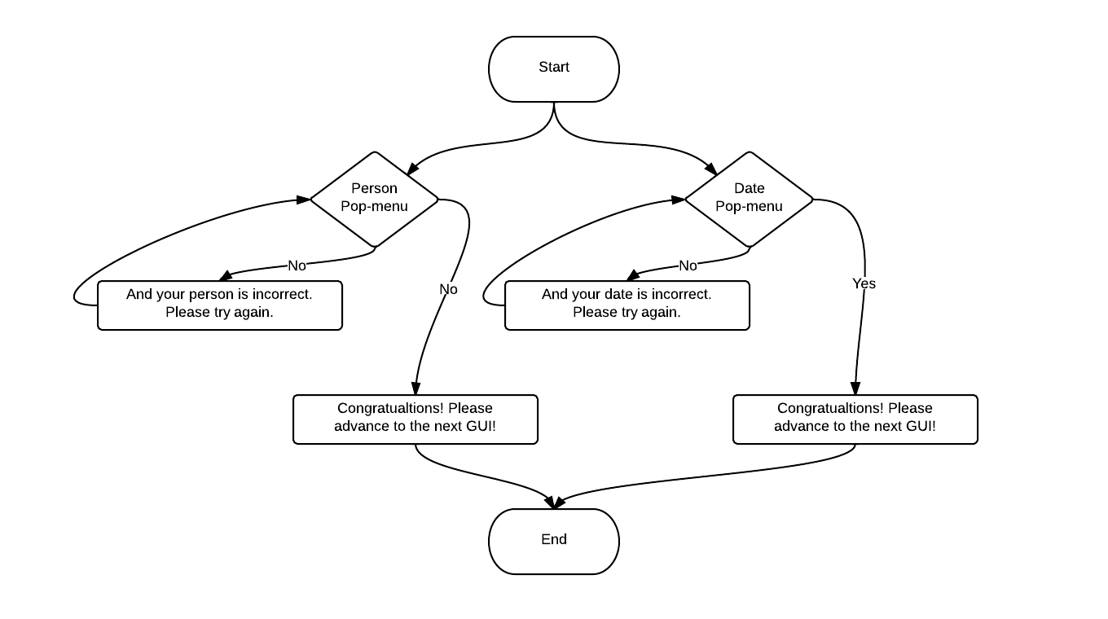
Nanotechnology in Biomedical Engineering - Introduction
Leigh Nelson will design this GUI.

Slide 8
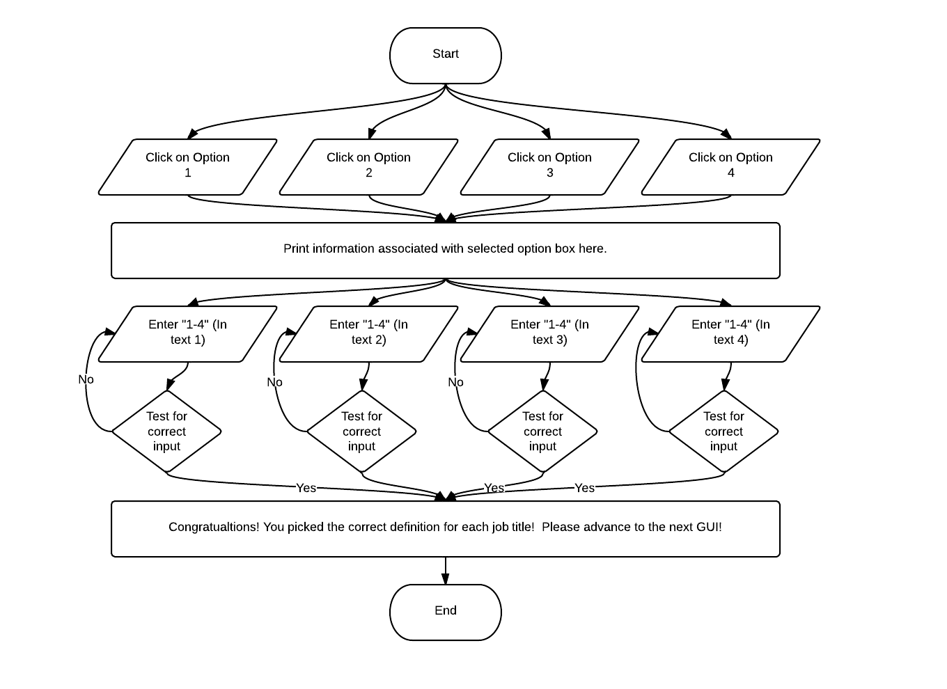
Nanotechnology in Biomedical Engineering - “Beginners Scaffolding”
Leigh Nelson will design this GUI.

Slide 9
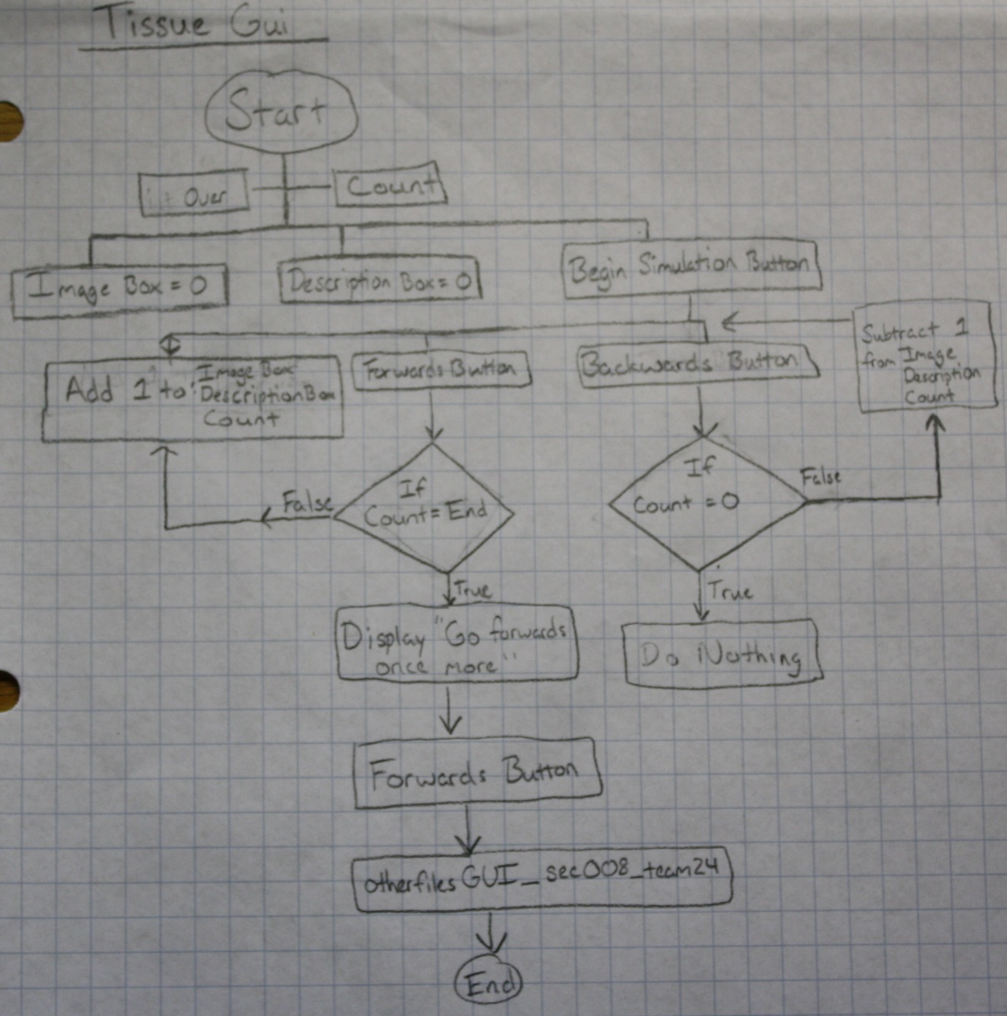
Nanotechnology in Biomedical Engineering - Regenerative Tissues
Adam Ribblett will design this GUI.

Slide 10
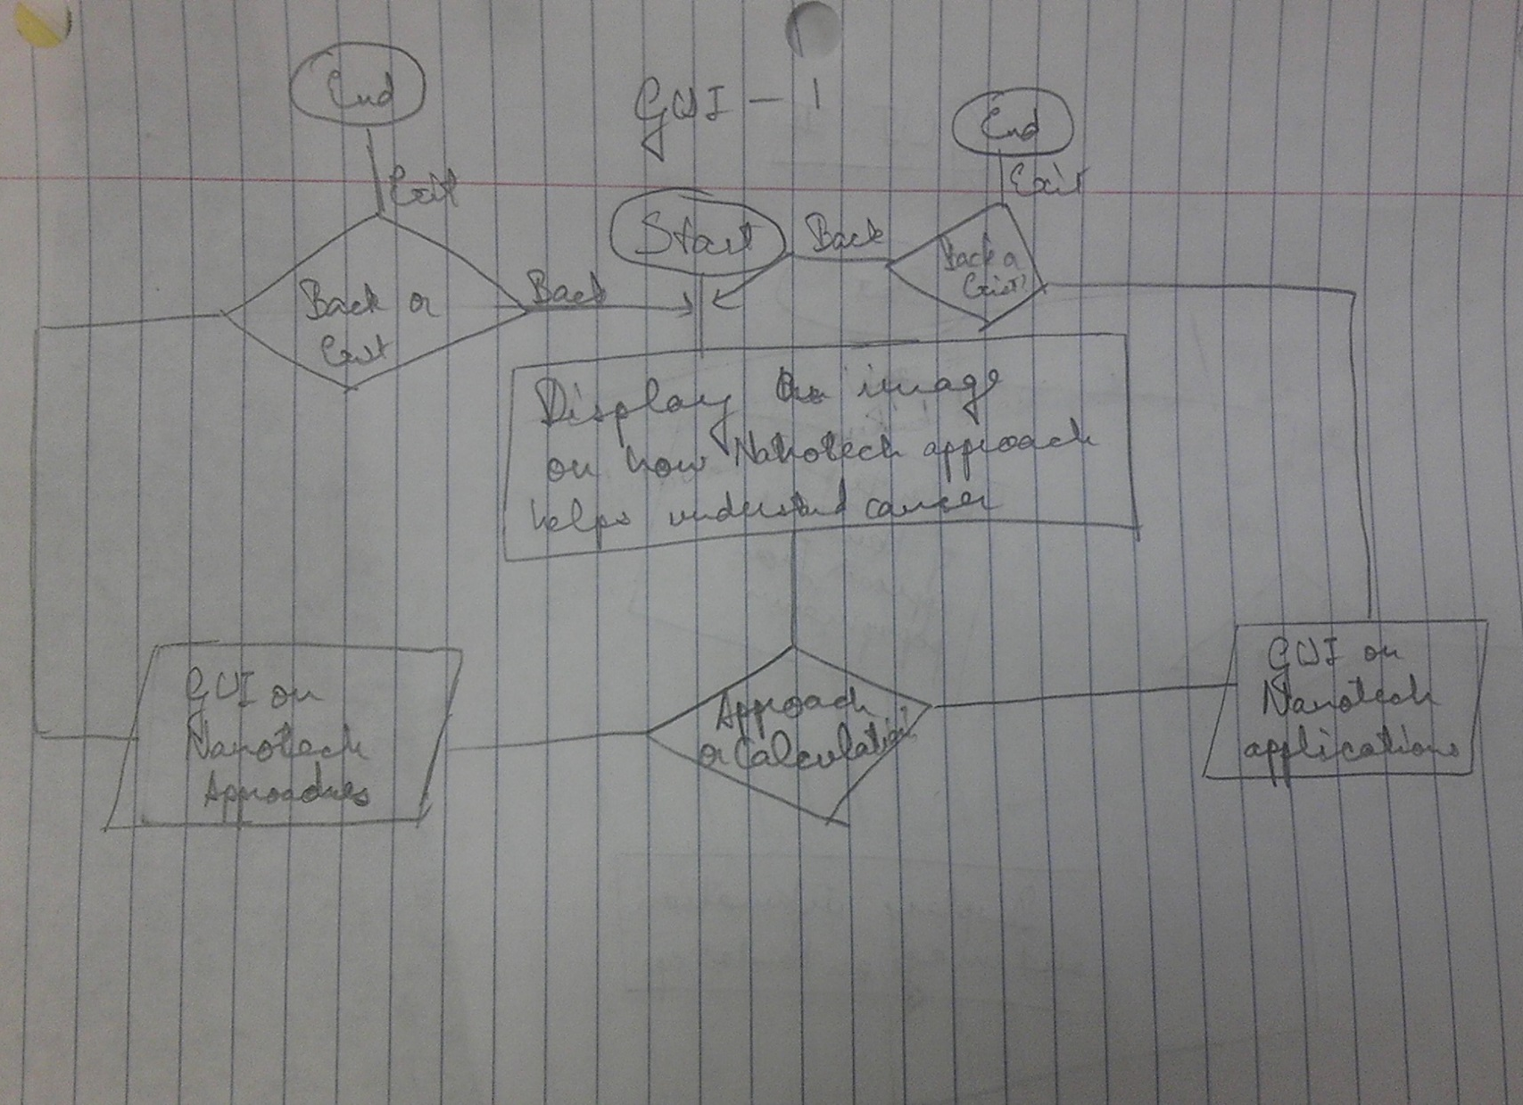
Nanotechnology in Biomedical Engineering – Cancer Research
Apoorv Gaur will design this GUI.

Slide 11
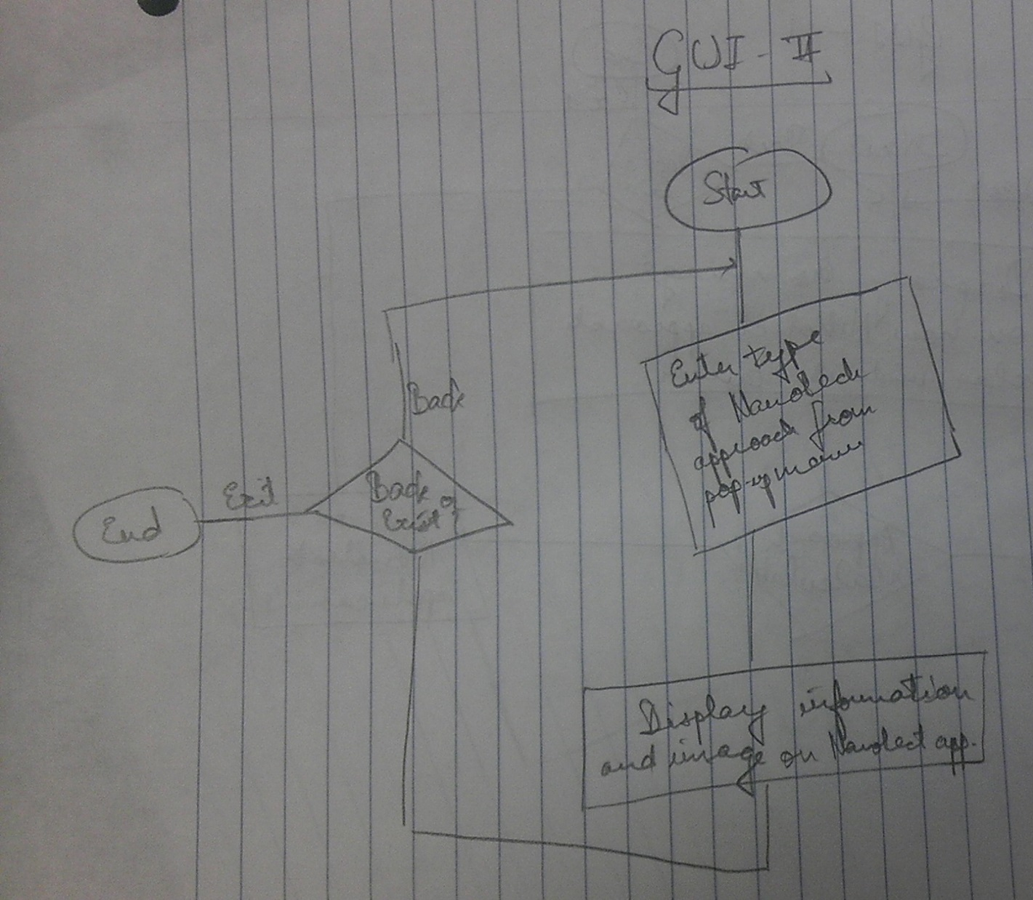
Cancer Research - Nanotechnology Approach
Apoorv Gaur will design this GUI.

Slide 12
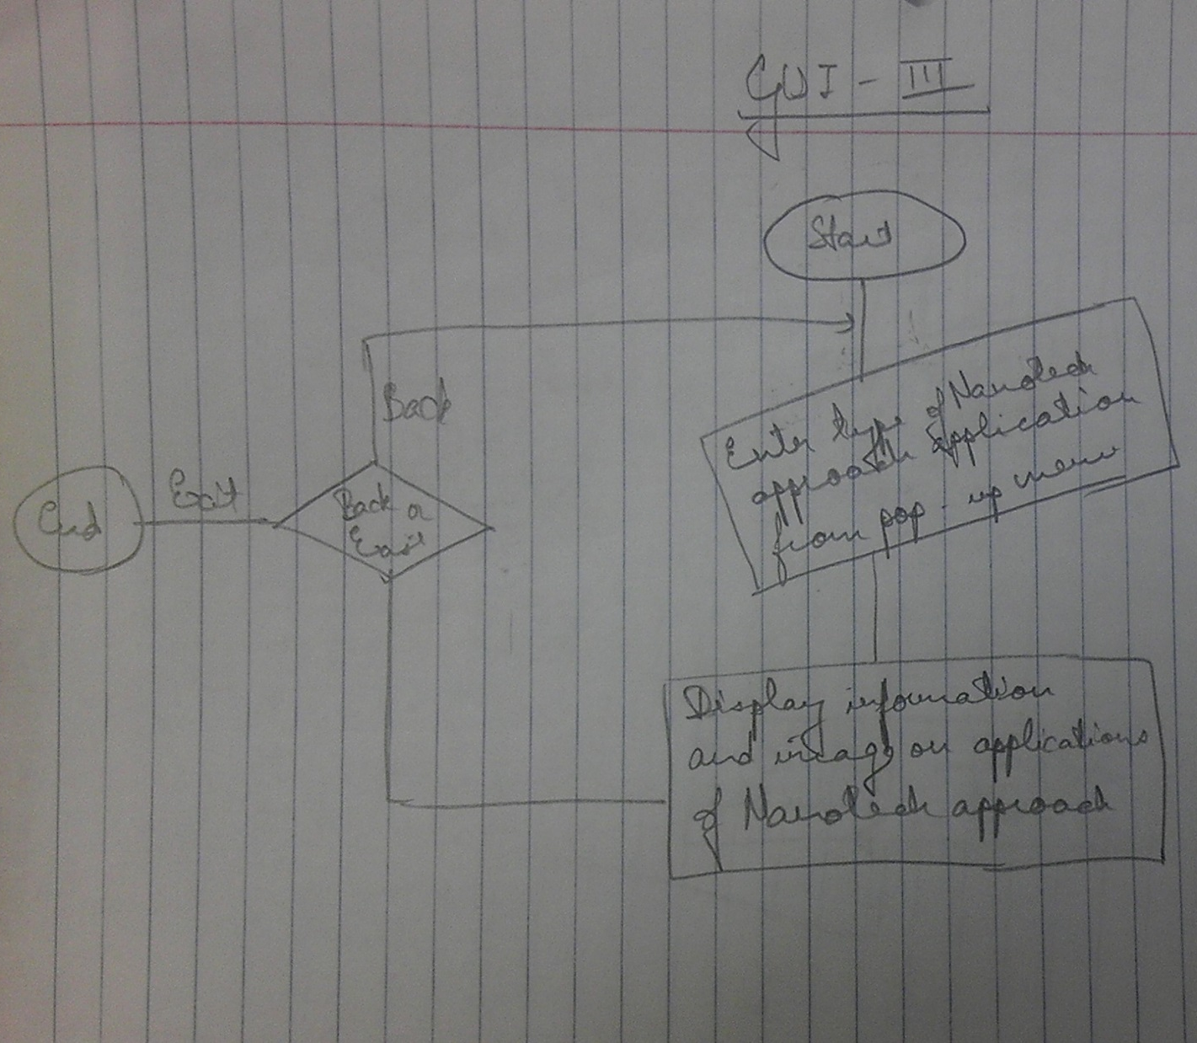
Cancer Research - Application of Nano-Technology Approach
Apoorv Gaur will design this GUI.

